Slide 1

Archie: a question answering model
CS6120: Natural Language Processing

Slide 2
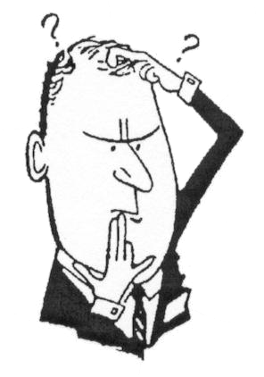


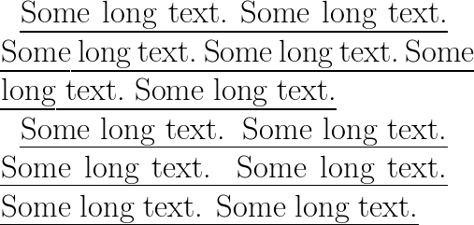
What are we working on?
Archie: Our question answering model

Slide 3
Background
Stanford Question Answering Dataset (SQuAD) is a reading comprehension dataset, consisting of questions posed by crowdworkers on a set of Wikipedia articles.
The answer to every question is a segment of text from the corresponding reading passage or the question might be unanswerable.
SQuAD 1.1, contains 81,386 question-answer pairs on 500+ articles.
The test data contained 4284 questions.
Objective of this project is to generate Neural Understanding models to read comprehension and match human intelligence in answering questions.

Slide 4

Our approach
SQuAD Dataset
Pre-Processing
VECTORS
Contextual Binding
(GloVe)
Train the Seq2Seq Model
(LSTM)
Evaluation
Configuring the Parameters

Slide 5
Data pre-processing
Context
Question
Answer
Answer Context
Training Data
Test Data
GLoVe: Global Vectors for Word Representation

Slide 6
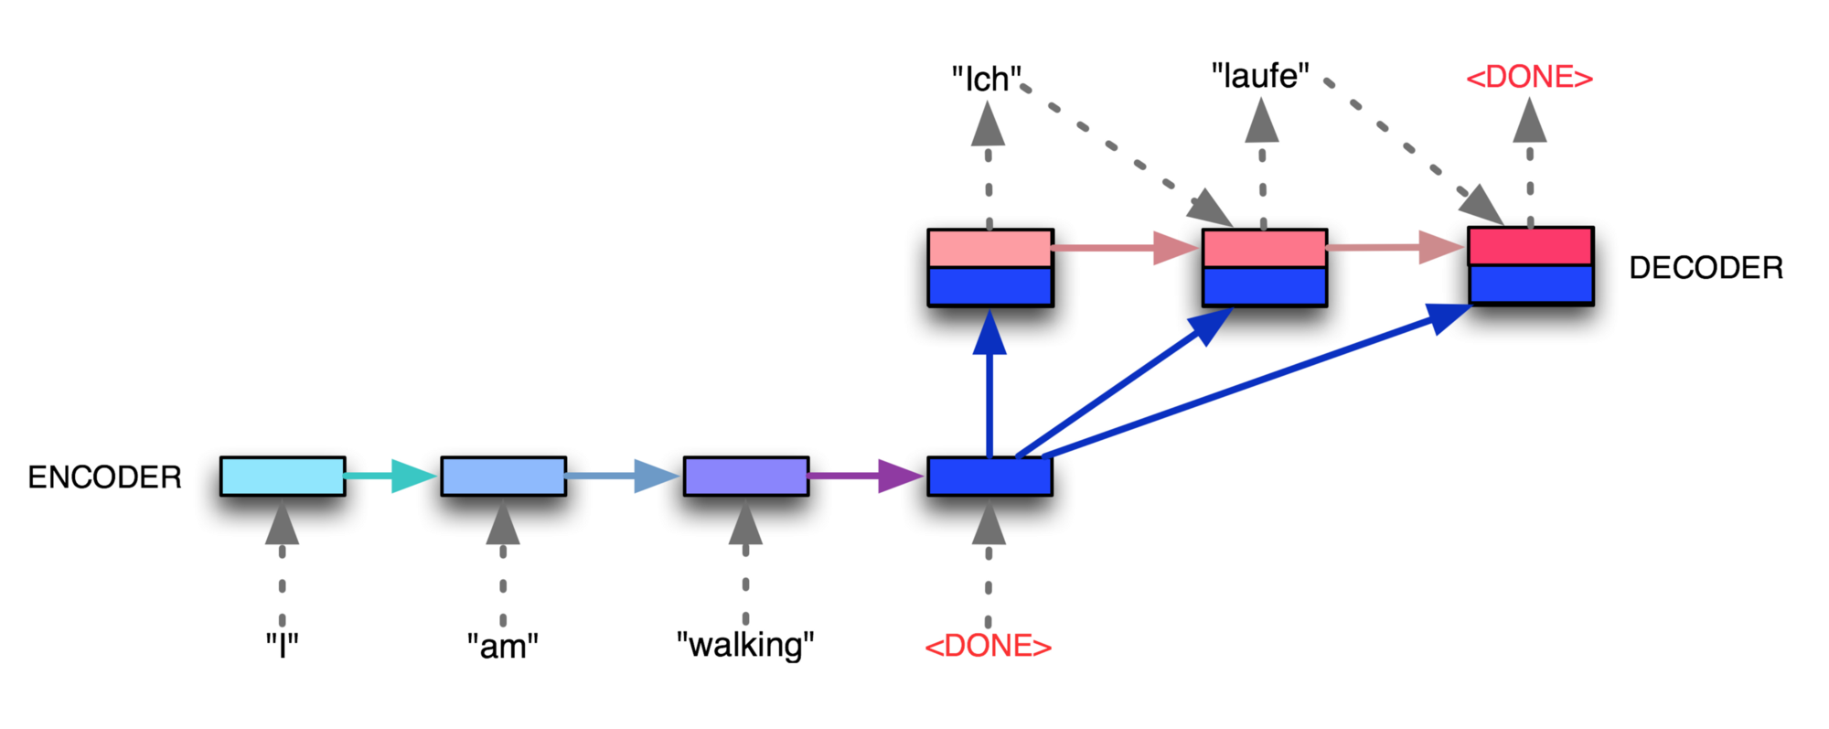
Sequence to Sequence Seq2Seq

Slide 7
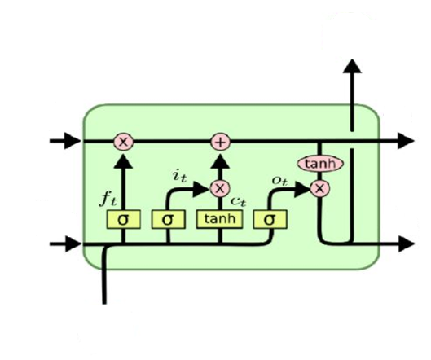
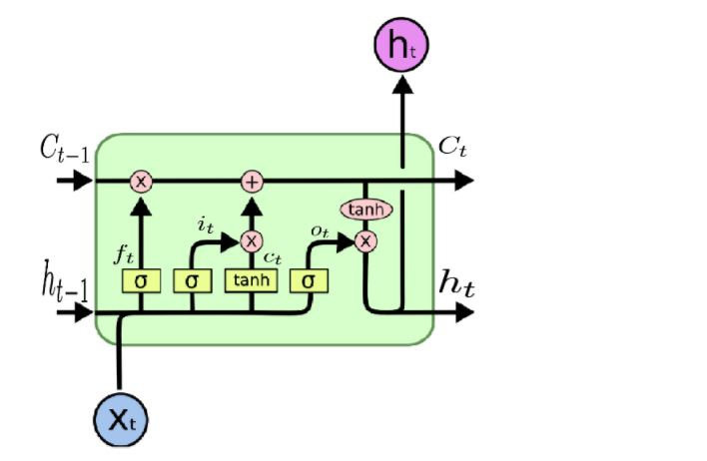
LSTM Architecture
Forget Gate
output gate
Input gate

Slide 8
How we did it! TRAINING OUR MODEL
Design a LSTM Layer based on RNN architecture
Set the evaluation function as Softmax
Define a loss function based on the accuracy function
Set optimizer parameter as ‘adam’
For LSTM we set the Keep probability as 0.75 to remember and if below that it forgets
Other hyperparameters we tuned:-
Learning Rate
Batch Size
Windows Size of LSTM
Hidden Size for number of nodes of LSTM
Sample used for evaluation of results

Slide 9

Adam Adaptive Moment Estimation
Combination of :-
1. AdaGrad – Adaptive Gradient
High change in value then suppress learning of weights
Low change in value then enhance learning of weights
2. RMSProp – Root Mean Sq. Propogation
Add weight/emphasis on recent backpropagation
Then the final formula for the Parameter update is -
M(t) and V(t) are values of the first moment which is the Mean and the second moment which is the uncentered variance of the gradients respectively.

Slide 10
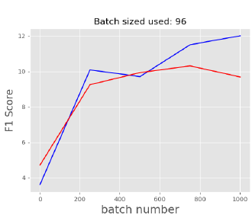
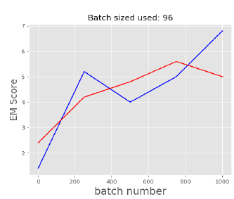
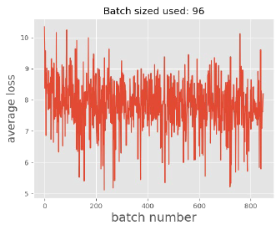
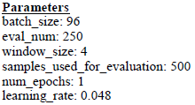
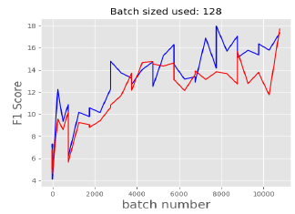
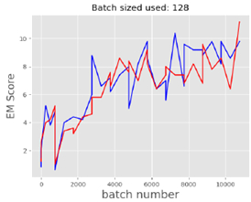
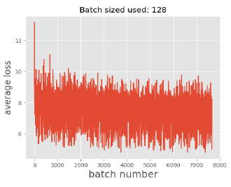
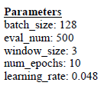
Evaluations and results!

Slide 11
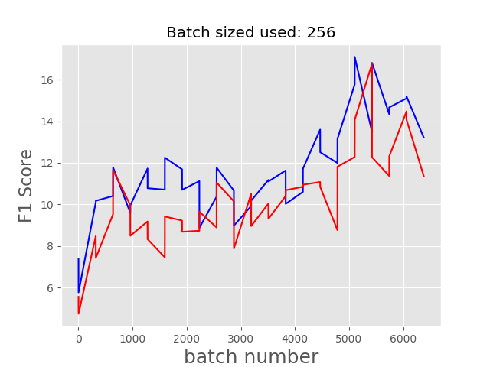
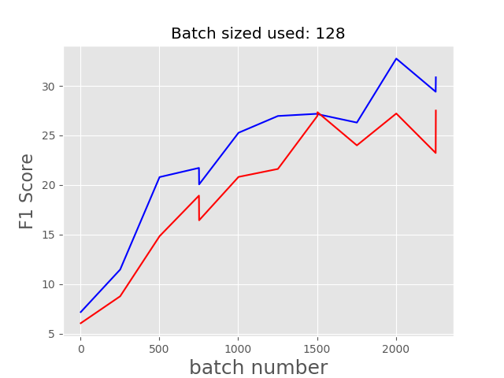
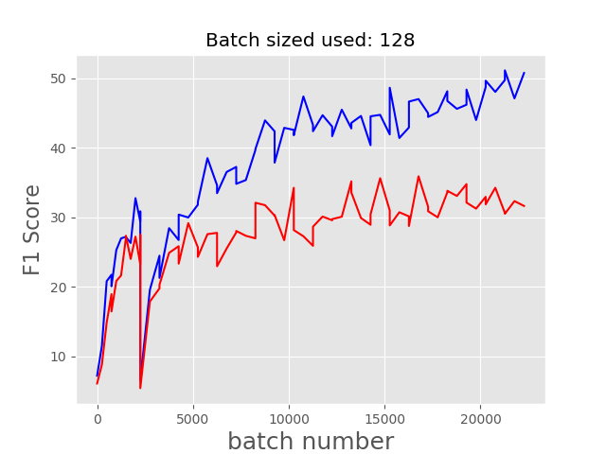
Evaluations and results!
eval_num : 250
window_size : 8
hidden_size : 200
num_epochs : 15
learning_rate : 0.0048
eval_num : 500
window_size : 10
hidden_size : 200
num_epochs : 20
learning_rate : 0.0048
eval_num : 500
window_size : 3
hidden_size : 200
num_epochs : 20
learning_rate : 0.048

Slide 12
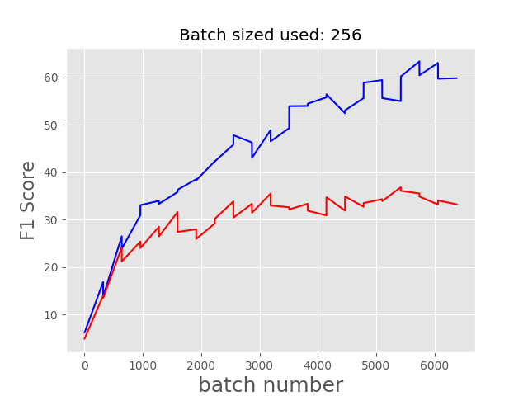
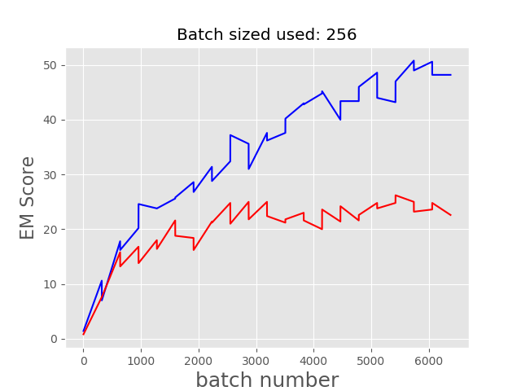
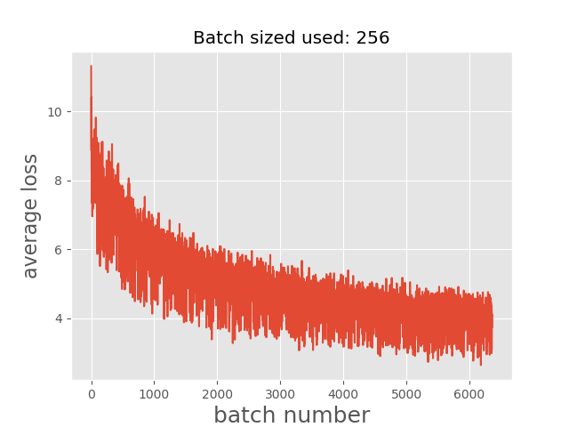
THE PROGRESS WE MADE!
batch_size : 256 window_size : 10 hidden_size : 200 num_epochs : 20 learning_rate : 0.003

Slide 13
Learning
Tensorflow usage and Deep Neural network Implementation
Version of packages in Python is very important as this is rapidly evolving field
Hyperparameter’s importance for deep neural network
Importance of which parameters to tune
LSTM, RNN implementation and knowledge about GRU(Gated Recurrent Unit)

Slide 14
FUTURE WORK!
GRU to replace LSTM have given better result for MS research
Process output back to text
Use CNN if possible to reduce computation and complexity

Slide 15

Questions?
THANK YOU!
Noul Singla
Vipul sharma

